Slide 1
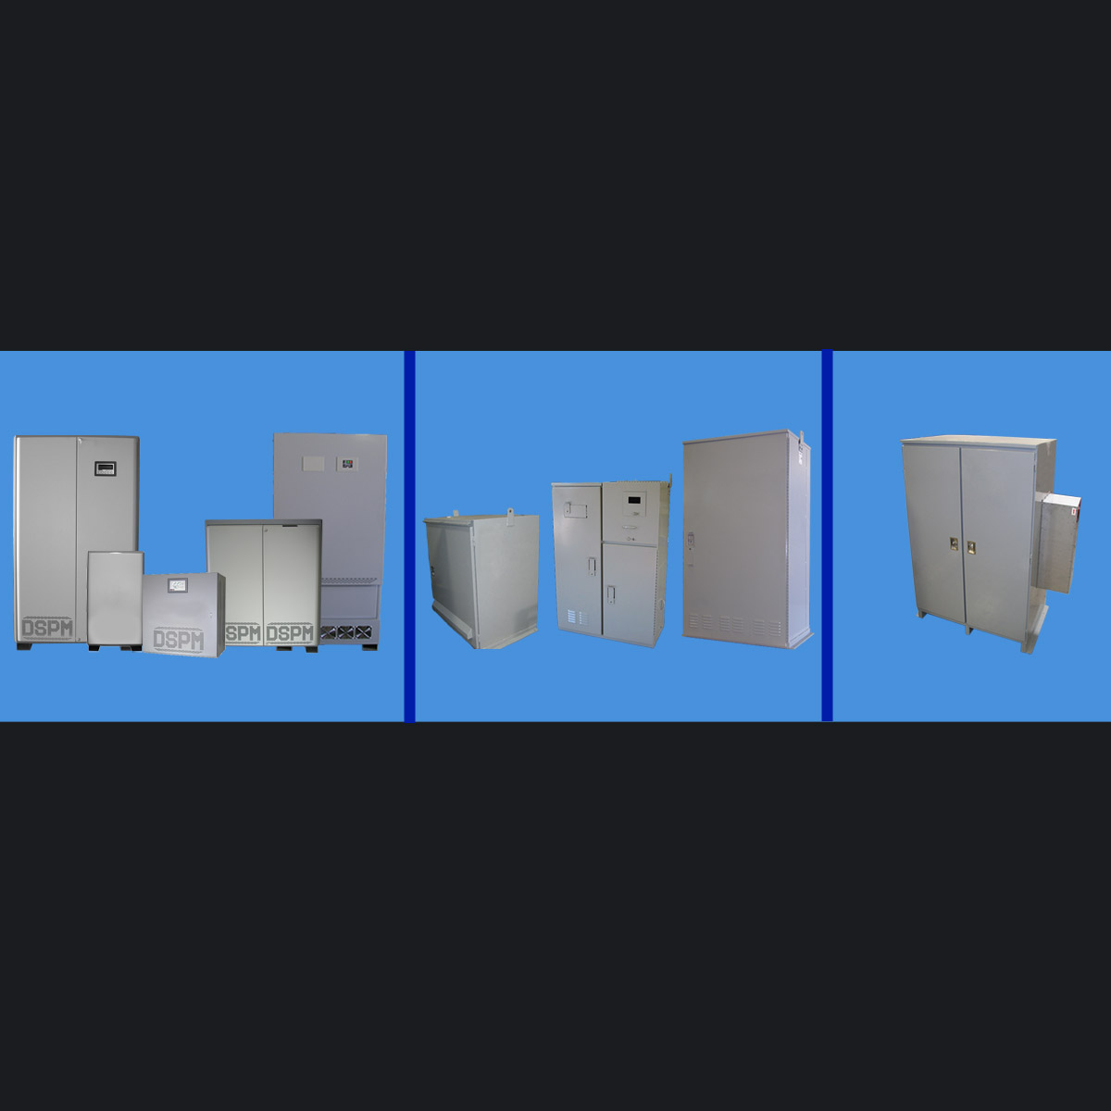

EMERGENCY LIGHTING PRODUCT
SEMINAR
NEMA 1
NEMA 3R
NEMA 4, 4X,12
Information based from the Life Safety Code Handbook® explaining the how, what, when, where, and why’s of emergency lighting as well as an in-depth explanation of DSPM’s Life Safety Compliant UL924 products.

Slide 2
LIFE SAFETY CODES I
(From Life Safety Code Handbook, 2012)
Fundamental Requirements
(4.5, Life Safety Code Handbook. 2012)
Provide adequate safety without dependence on any single safeguard.
Provide an appropriate degree of life safety considering the size, shape, and nature of the occupancy.
Provide for backup or redundant egress arrangements.
Ensure that the egress paths are clear, unobstructed, and unlocked.
Ensure that the exits and egress routes are clearly marked to avoid confusion and provide the cues needed for their effective use.
Provide adequate lighting.
Ensure prompt occupant response by providing early warnings.
Ensure the required systems facilitate and enhance situation awareness.
Ensure the suitable enclosure of vertical openings.
Ensure compliance with applicable installation standards.
Maintain all required features in proper working order.

Slide 3
LIFE SAFETY CODES I
(From Life Safety Code Handbook, 2012)
Code Requirements
Means of Egress
(Sections 4.5.3.4 and 4.5.8, Life Safety Handbook, 2012)
Lighting: Where artificial illumination is needed in a building or structure; egress facilities shall be included in the lighting design.
Maintenance: Whenever or wherever any device, equipment, system, condition, arrangement, level of protection, or any other feature is required for compliance with the provisions of this code, such device, equipment, condition, arrangement, level of protection, or other feature shall thereafter be maintained, unless the code exempts such maintenance.

Slide 4
EMERGENCY LIGHTING
(From Life Safety Code Handbook, 2012)
Performance of System
(7.9.2.1, Life Safety Code Handbook, 2012)
Emergency illumination shall be provided for at least 90 minutes in the event of failure of normal lighting.
Emergency lighting facilities shall be arranged to provide initial illumination that is not less than an average of 10.8 lux (1 ft-candle) and, at any point, not less than 1.1 lux (0.1 ft-candle), measured along the path of egress at floor level.
Illumination levels shall be permitted to decline to not less than an average of 6.5 lux (0.6 ft-candle) and, at any point, not less than 6.5 lux (0.06 ft-candle) at the end of the 90 minutes. A maximum illumination uniformity ratio of 40 to 1 shall not be exceeded.

Slide 5
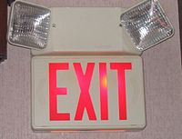
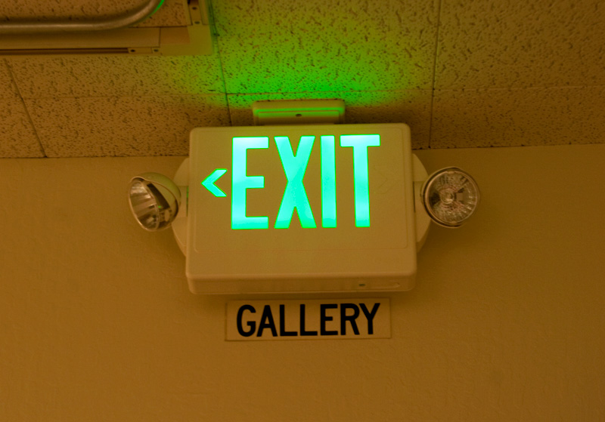
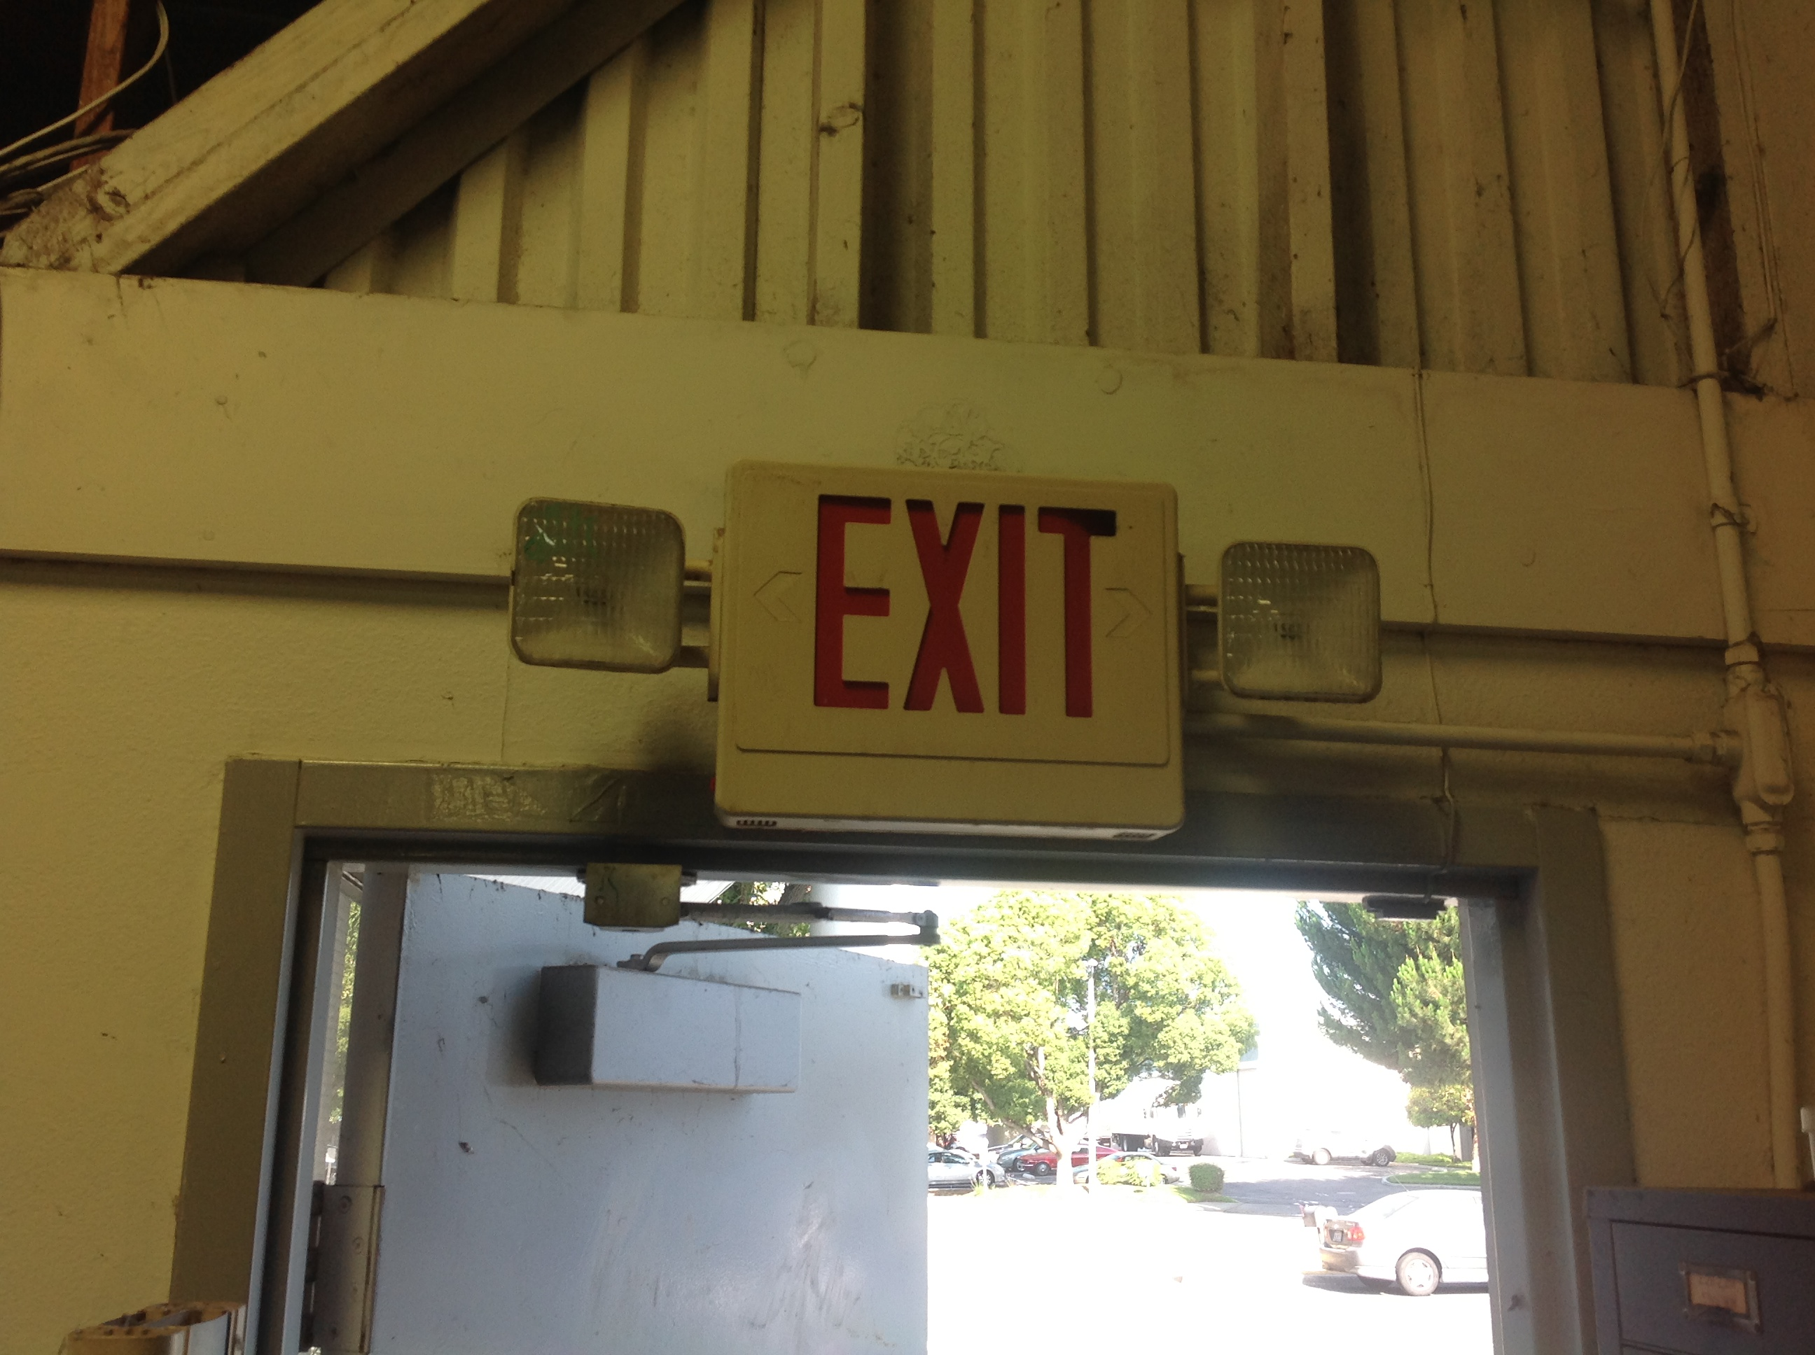
CURRENT SOLUTIONS
Examples of the current solutions used in various locale:
Bug Eyes / Exit Signs

Slide 6
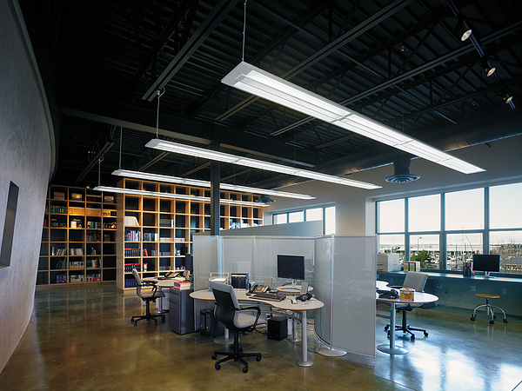
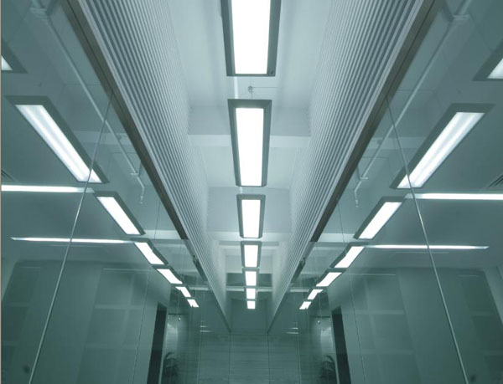
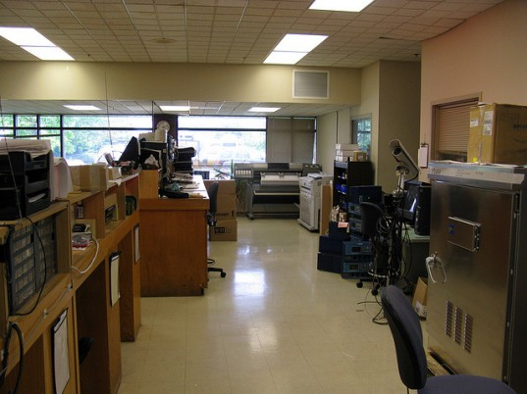
CURRENT SOLUTIONS
Examples of the current solutions used in various locale:
Battery Pack For Lamps

Slide 7
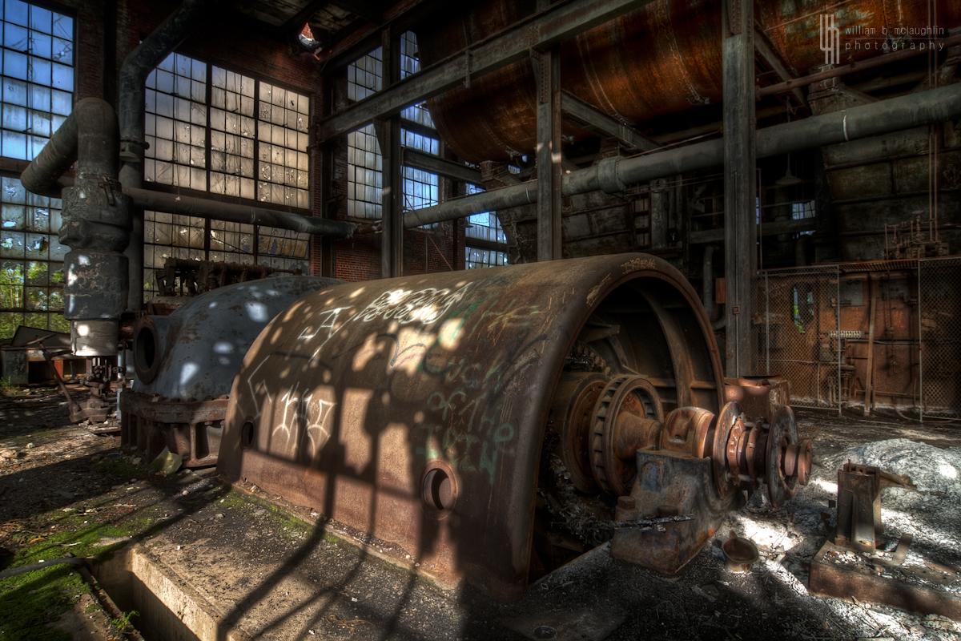
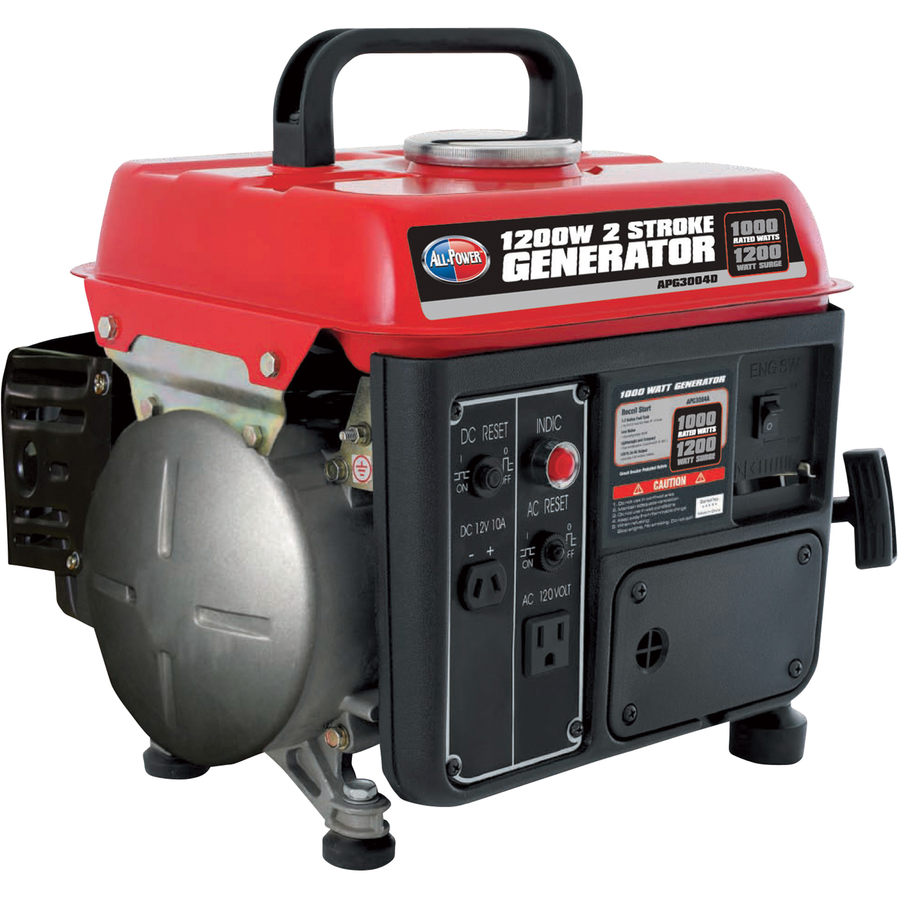
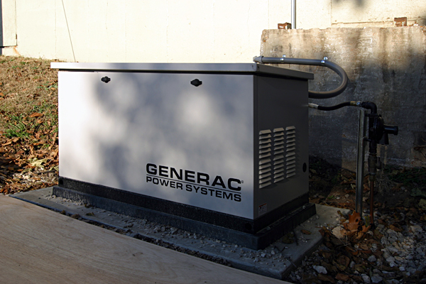
CURRENT SOLUTIONS
Examples of the current solutions used in various locale:
Power Generator

Slide 8
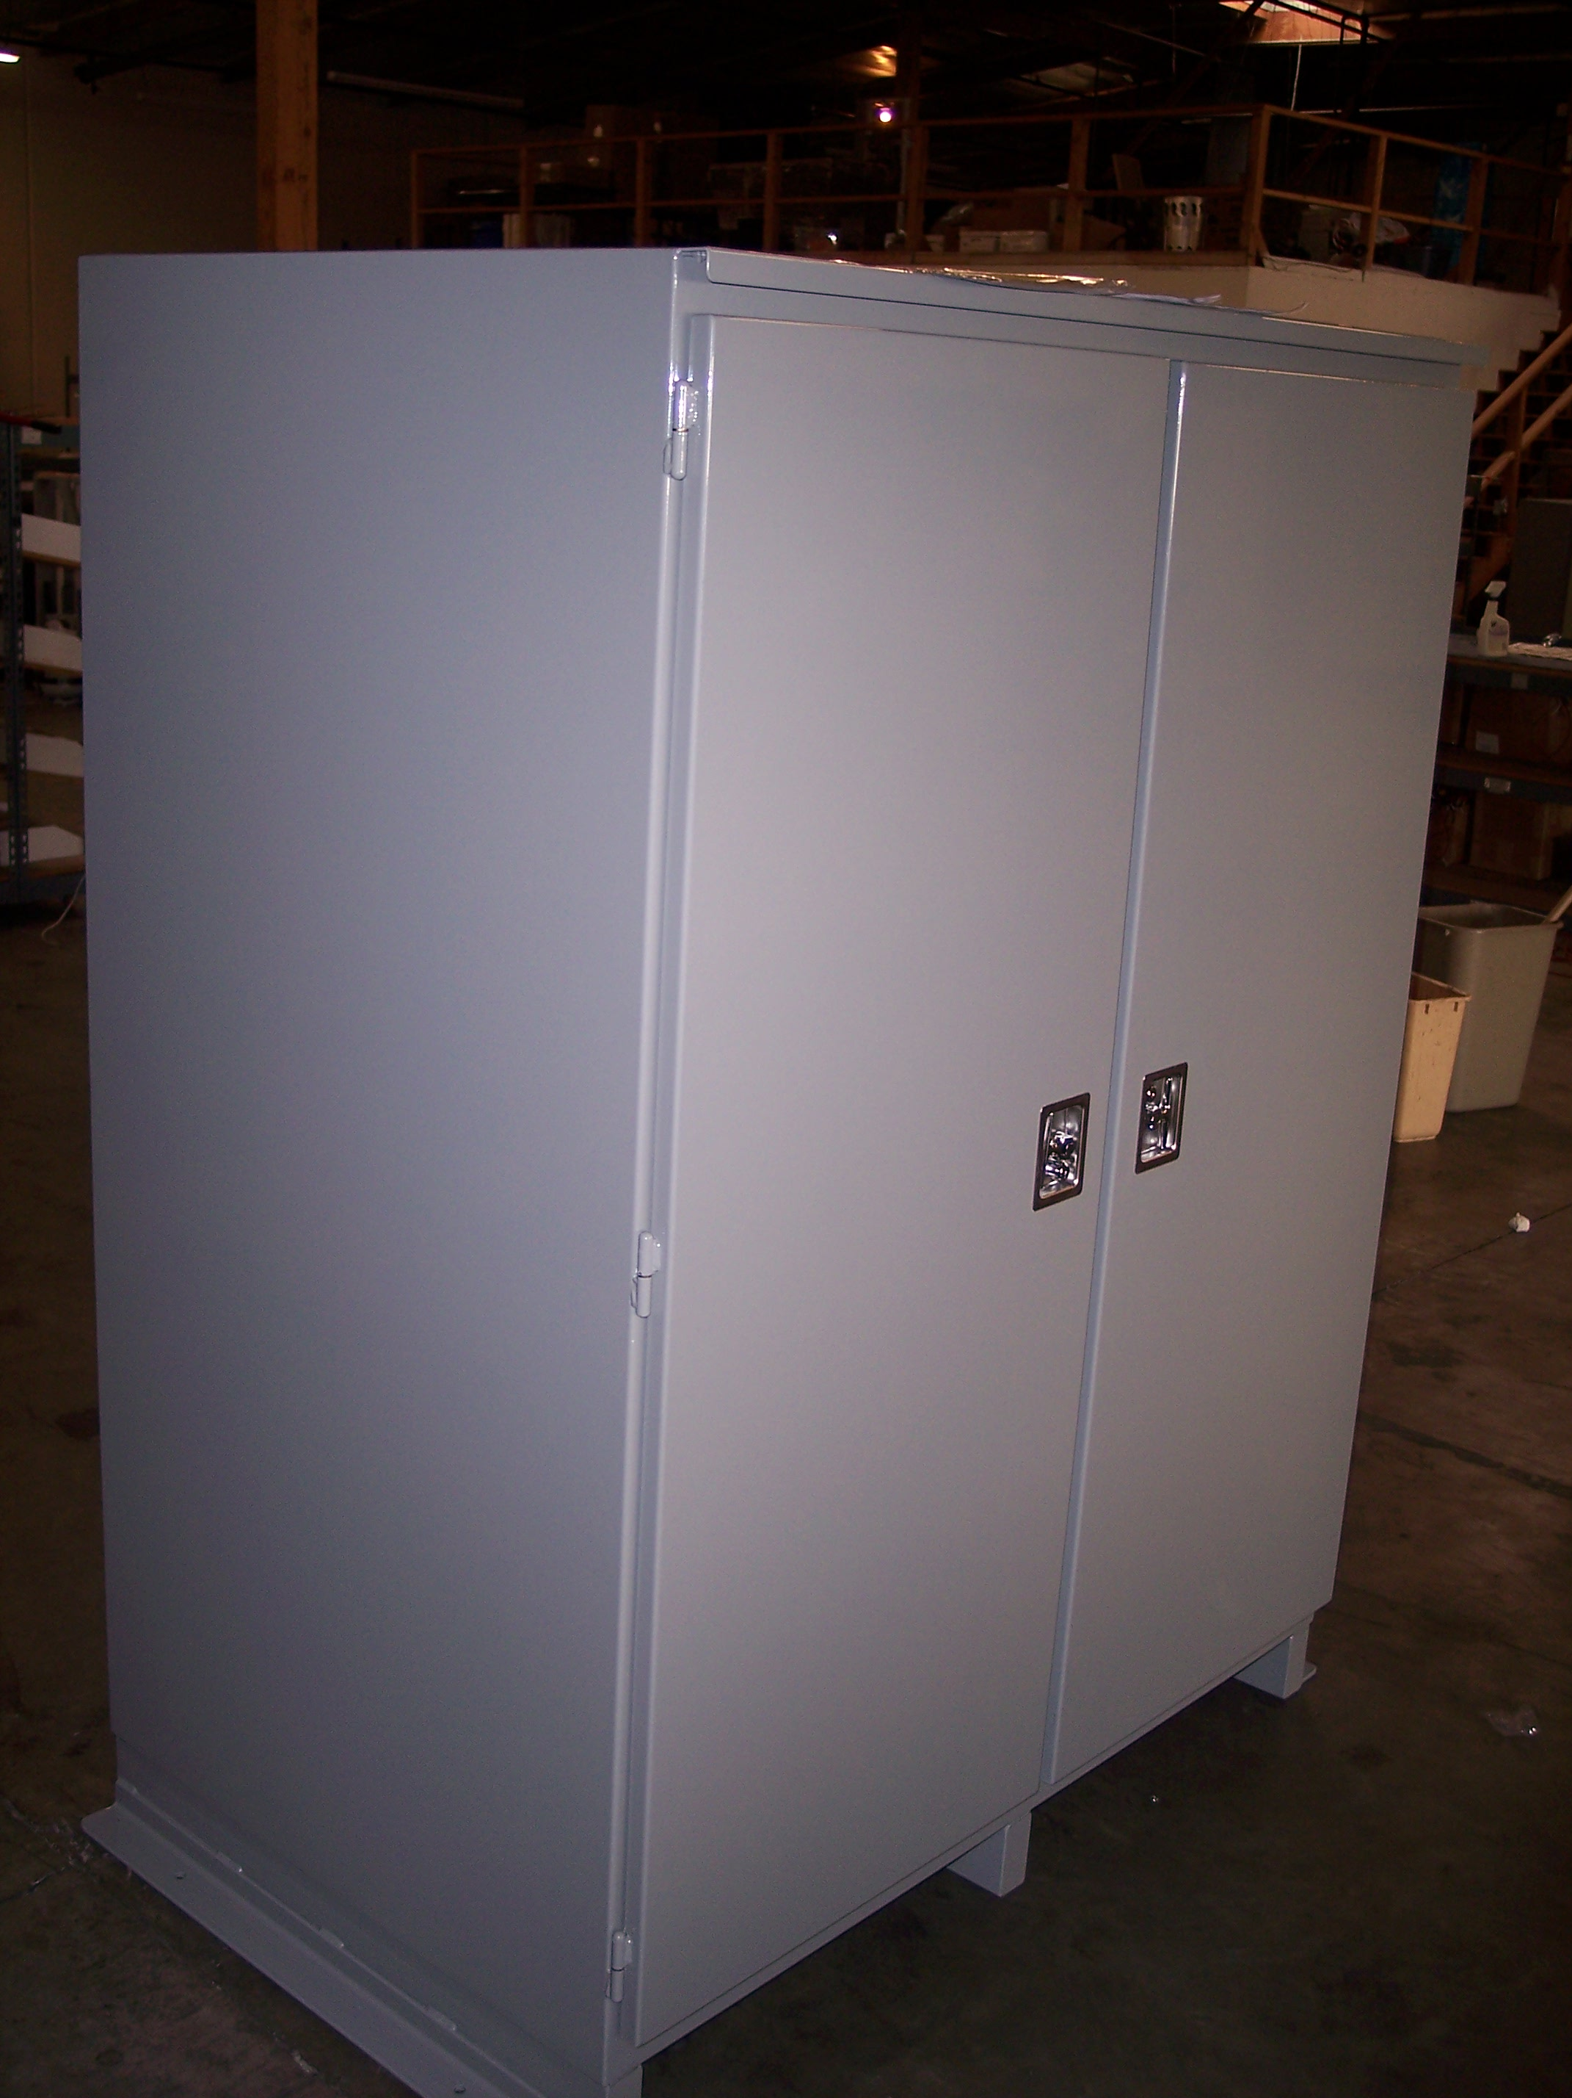
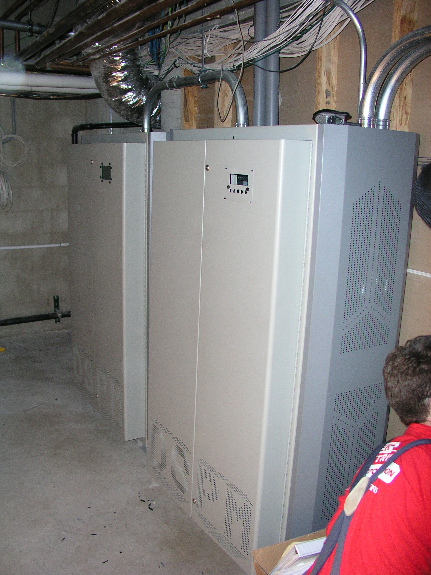
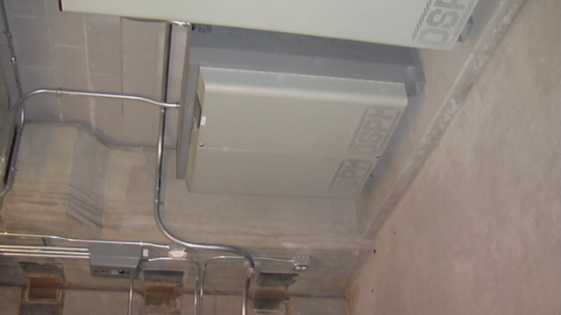
CURRENT SOLUTIONS
Examples of the current solutions used in various locale:
Inverter

Slide 9
CENTRALIZED
LIGHTING
INVERTER
EXAMPLES

Slide 10
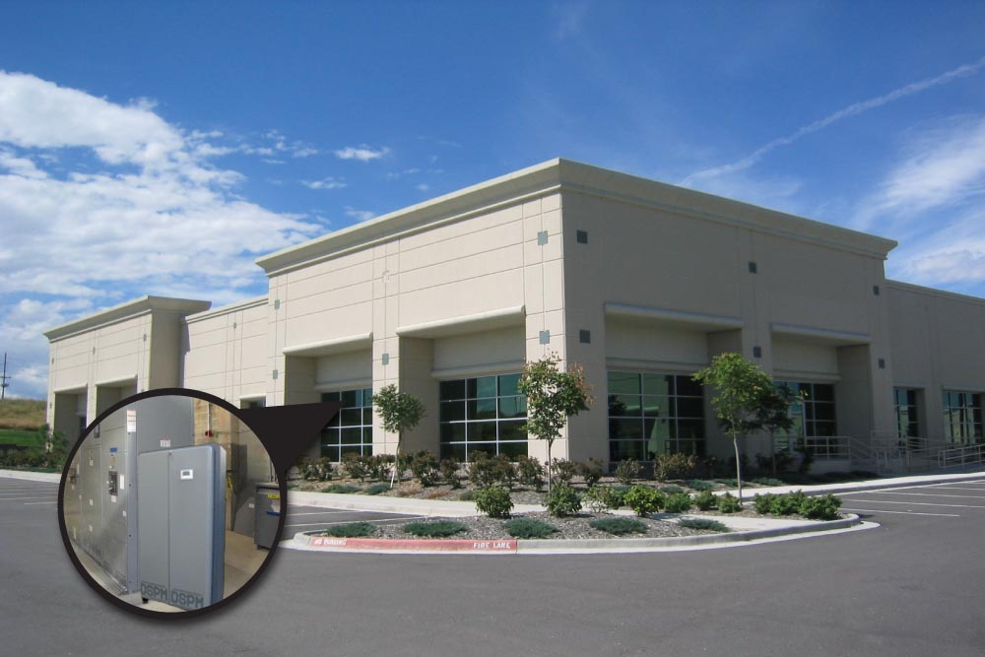
SINGLE UNIT SINGLE FLOOR

Slide 11
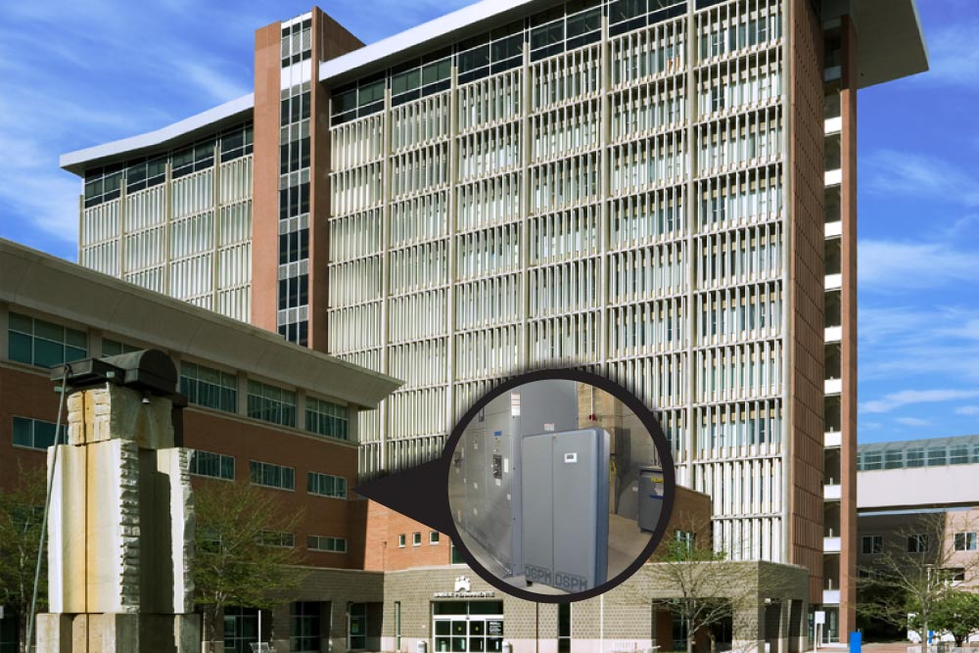
SINGLE UNIT MULTIFLOOR

Slide 12
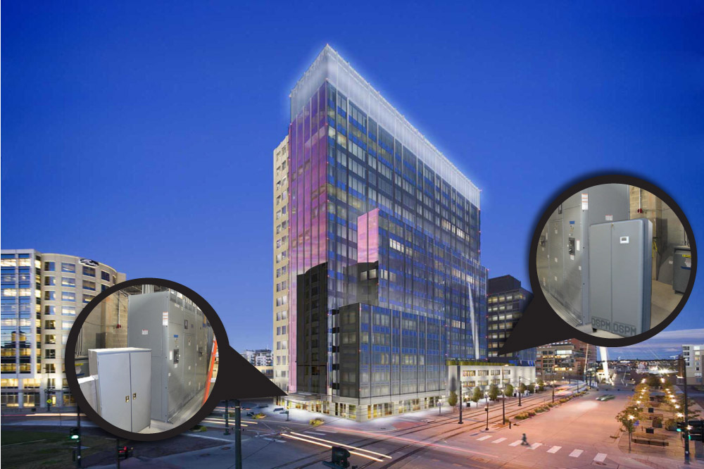
MULTI-UNIT MULTIFLOOR

Slide 13
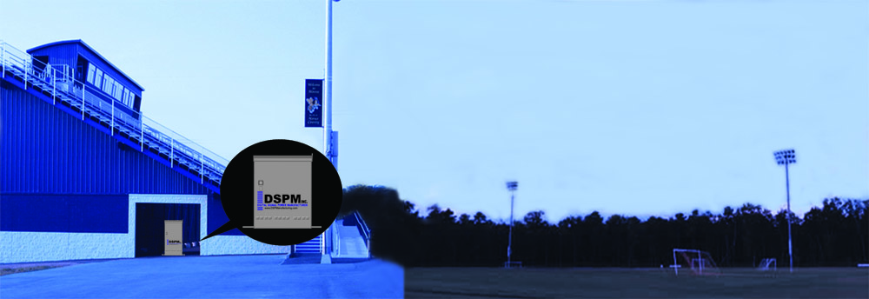
OUTDOOR INVERTER

Slide 14

EMERGENCY LIGHTING INVERTER SERIES

Slide 15

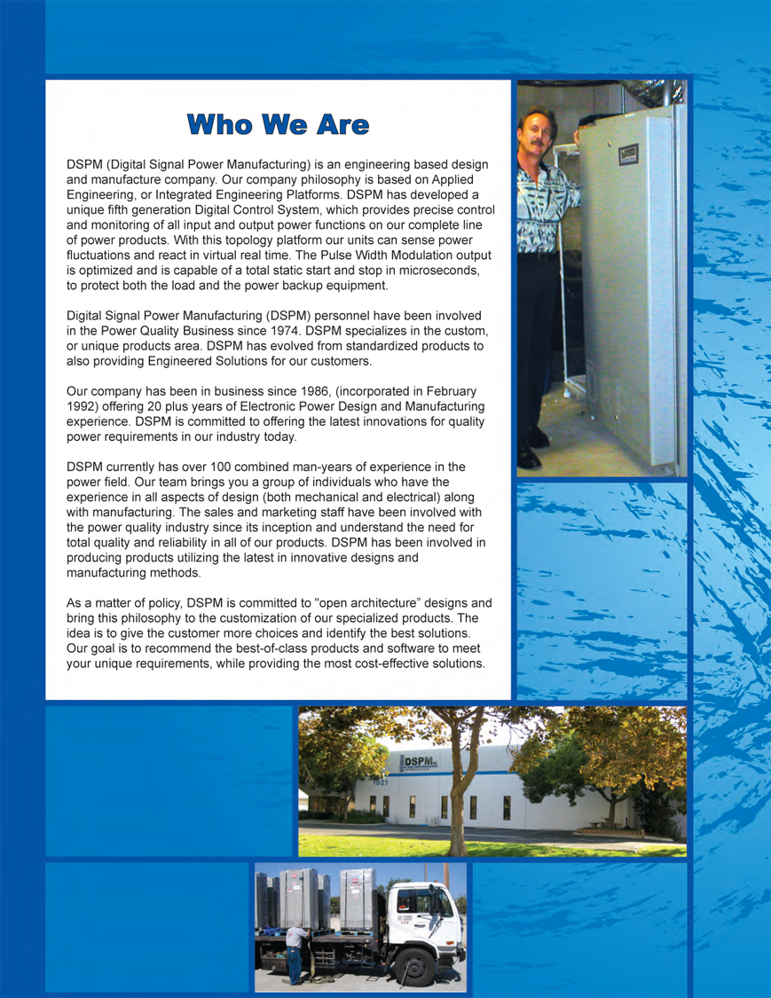
CORPORATE BROCHURE

Slide 16
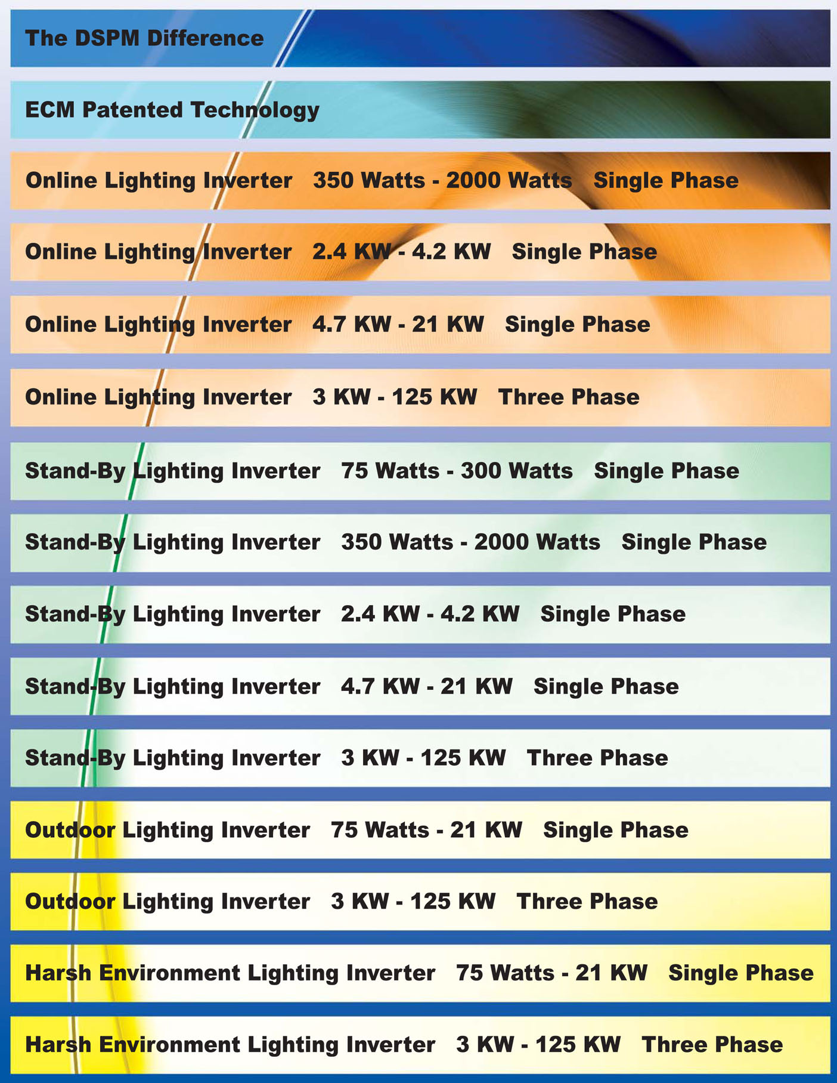
FAMILY LINE OF PRODUCTS
Defender
Series
Cobra
Series
Fortress
Series

Slide 17
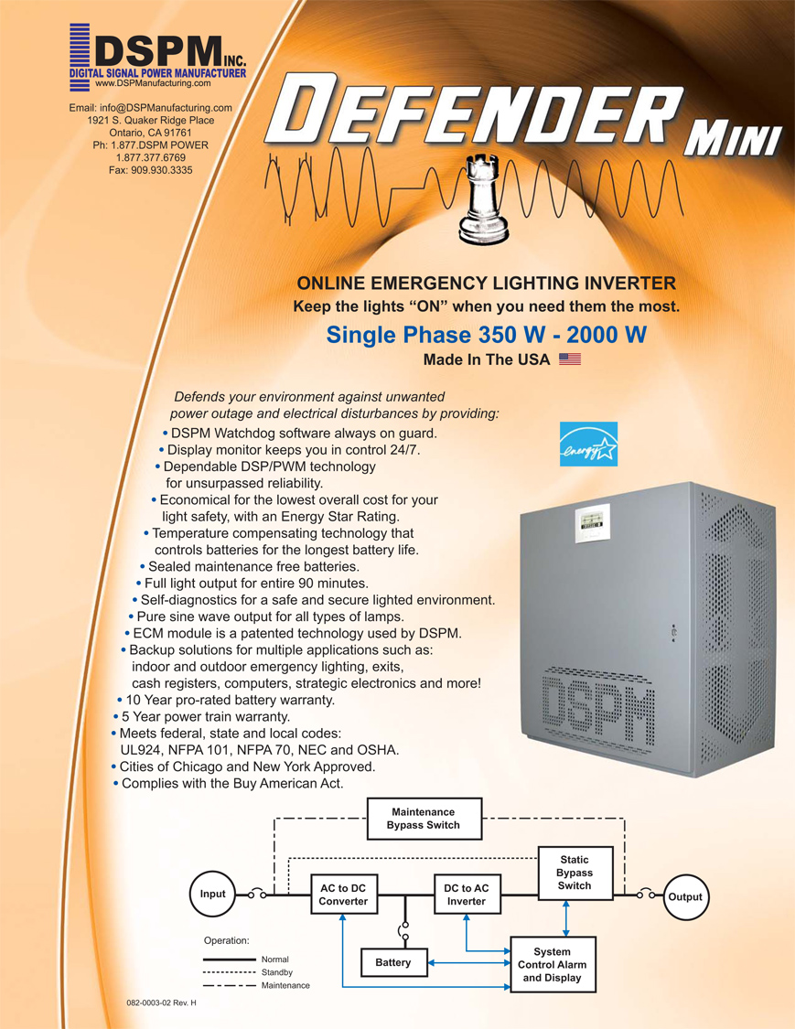
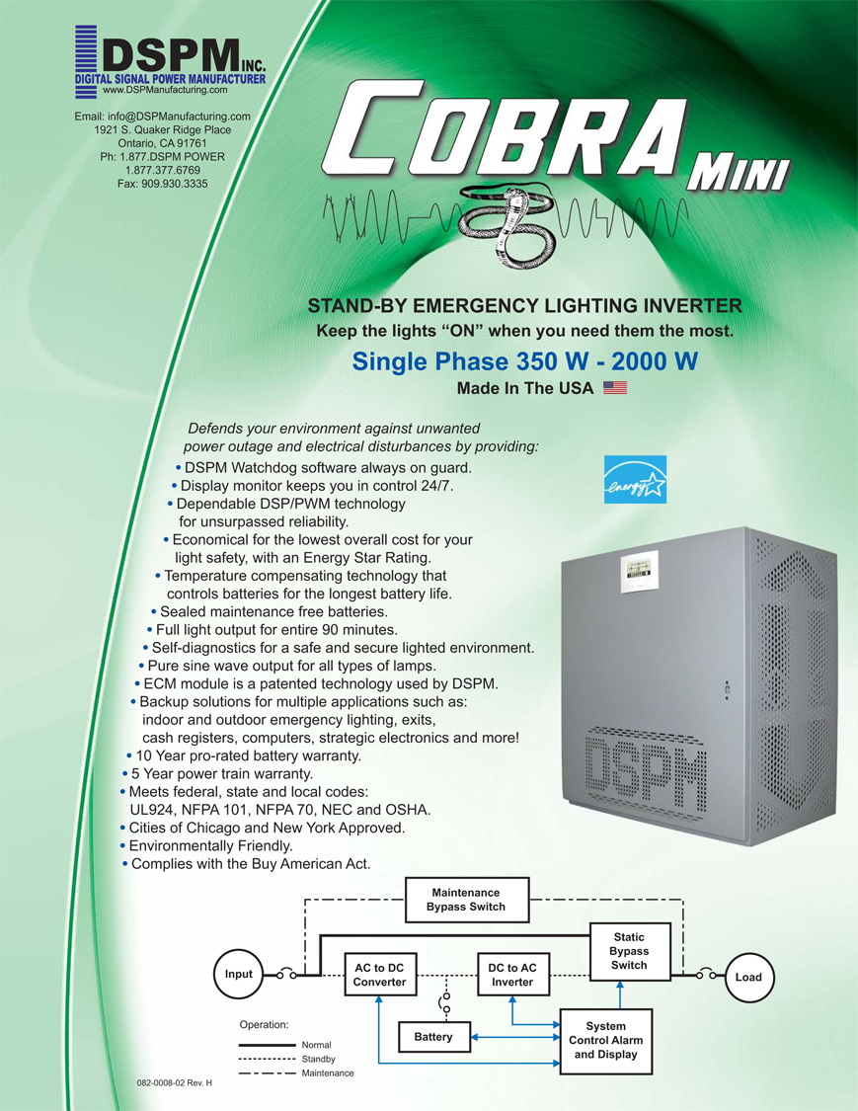
SINGLE PHASE 350W – 2000W

Slide 18
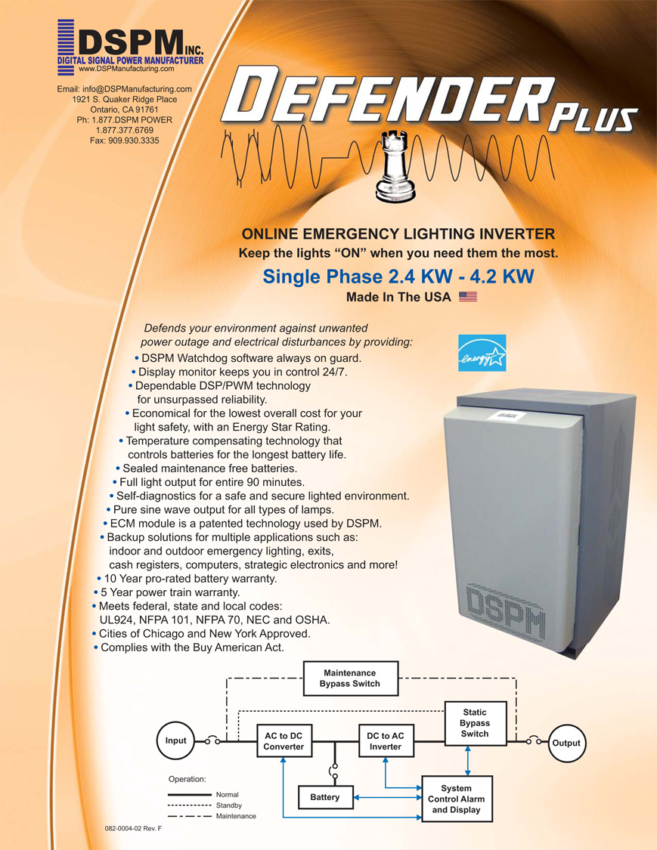
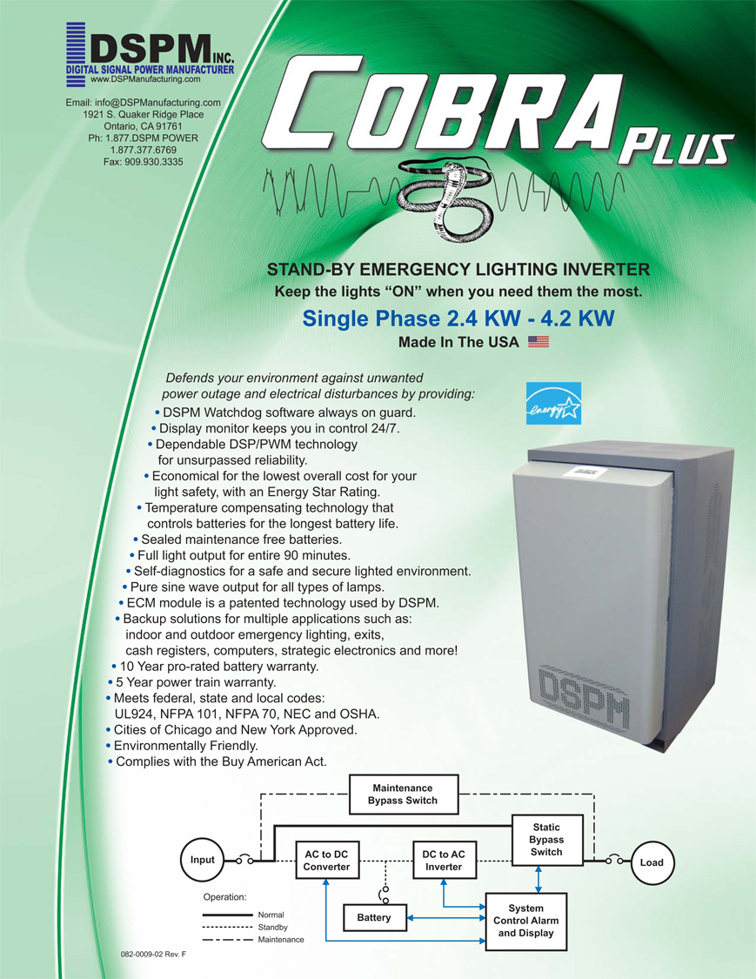
SINGLE PHASE 2.4KW – 4.2KW

Slide 19
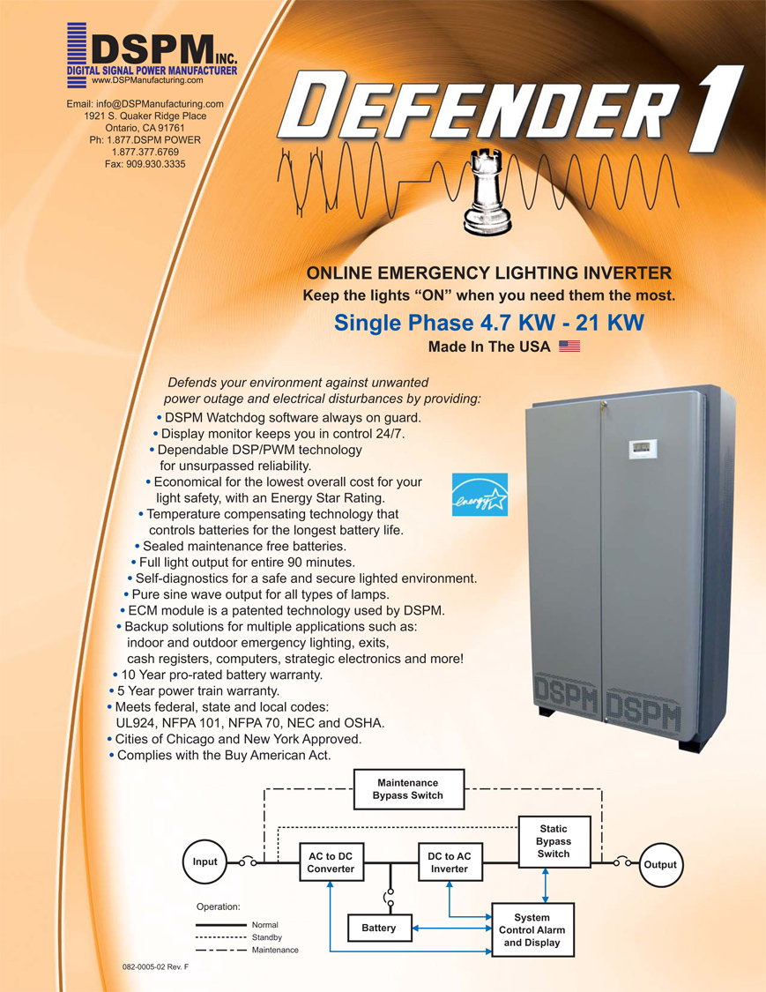
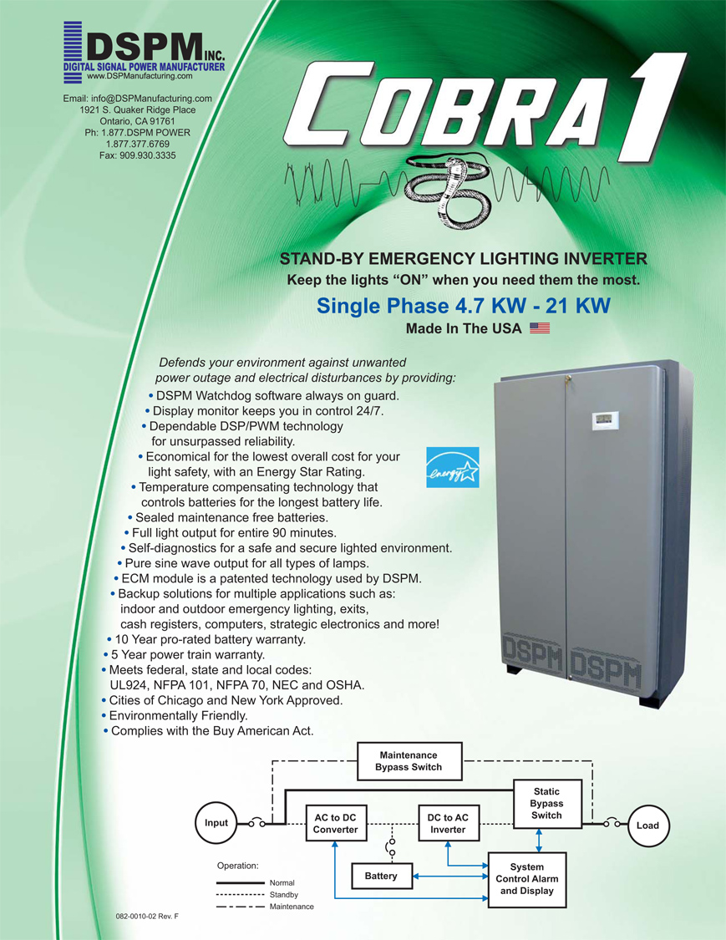
SINGLE PHASE 4.7KW – 21KW

Slide 20
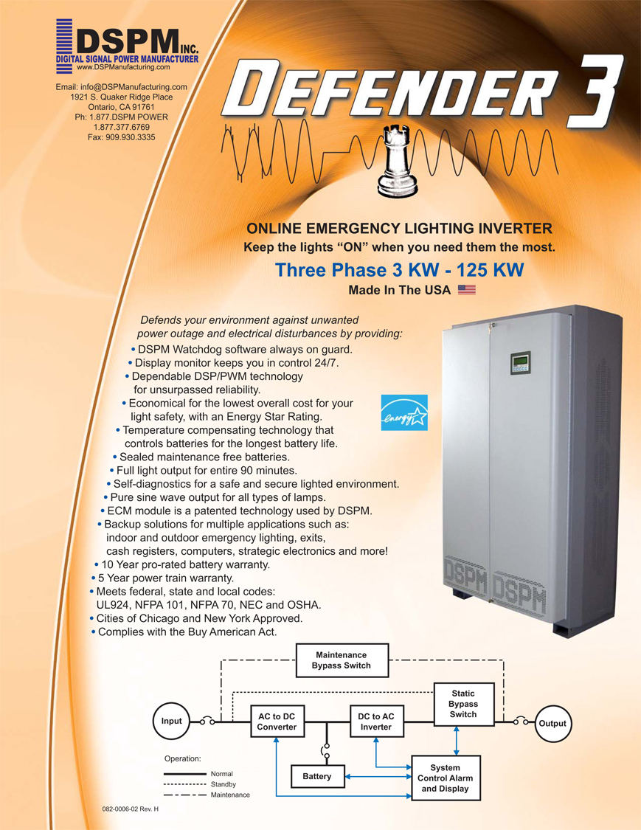
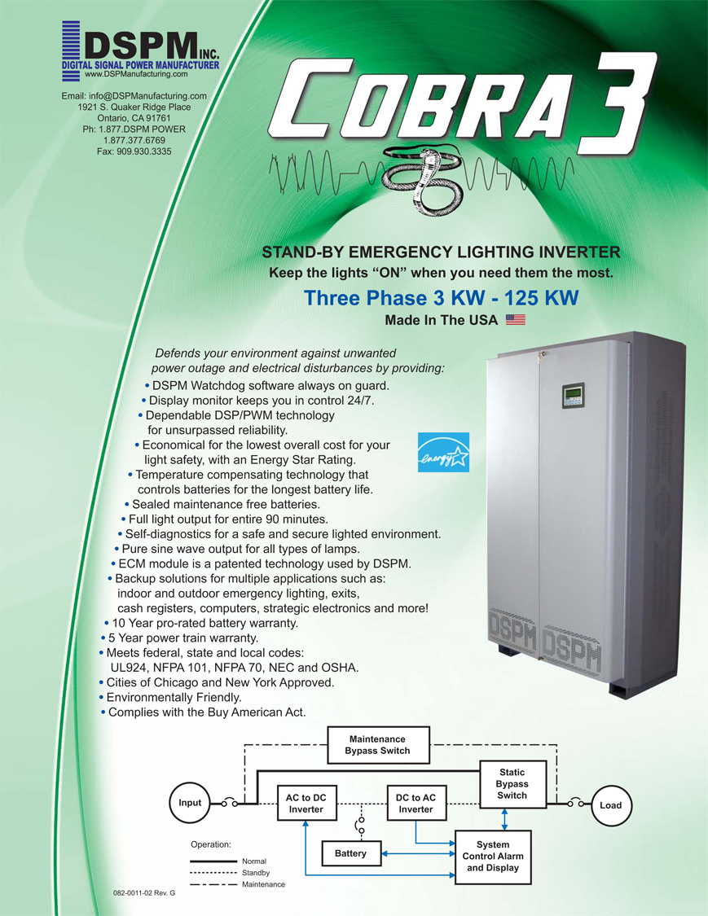
THREE PHASE 3KW – 125KW

Slide 21
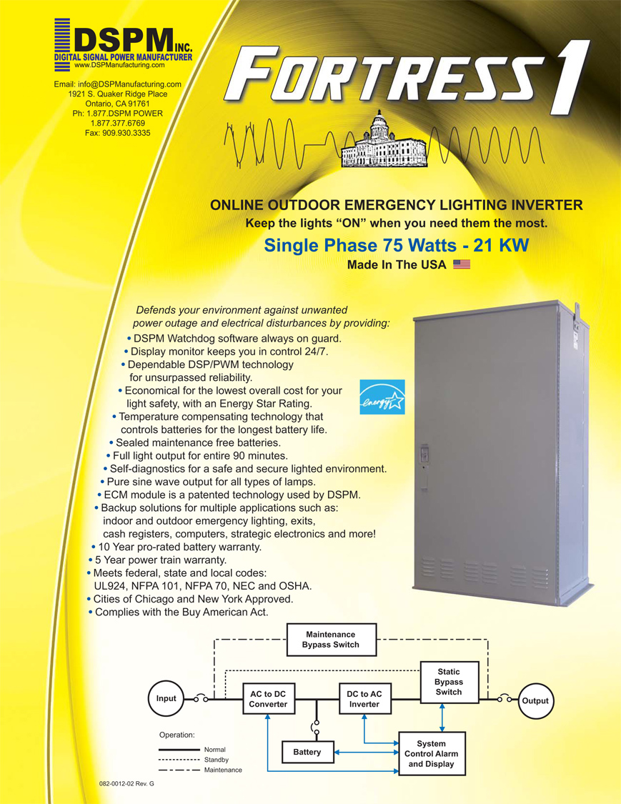
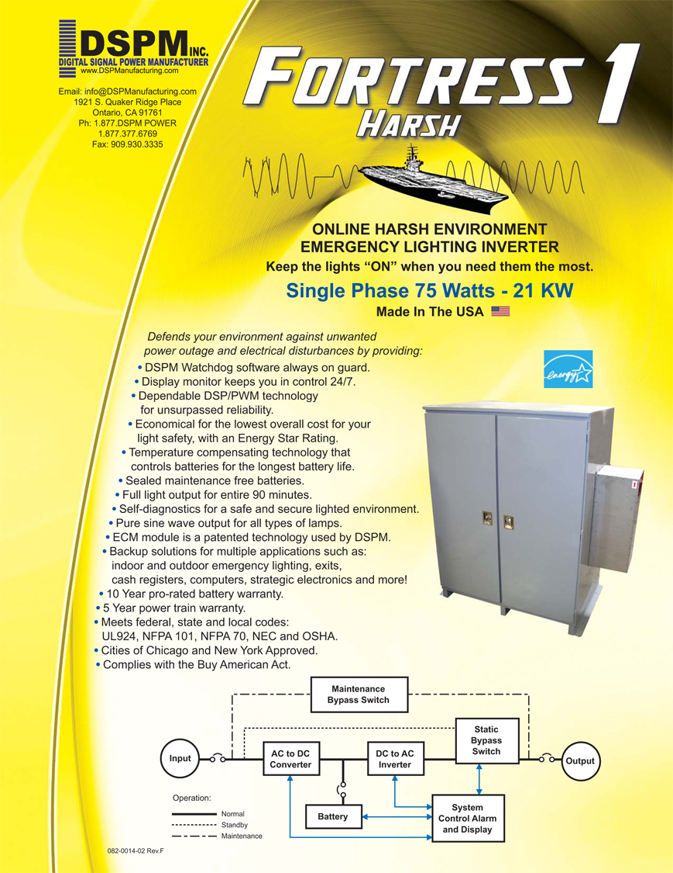
SINGLE PHASE 75W – 21KW
Outdoor Lighting Inverter

Slide 22


THREE PHASE 3KW – 125KW
Outdoor Lighting Inverter

Slide 23
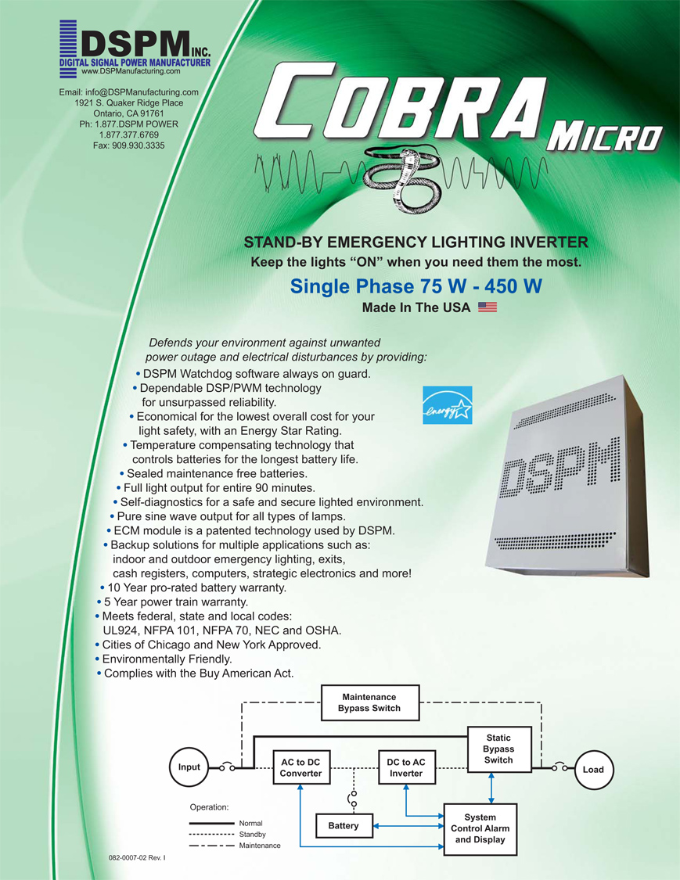
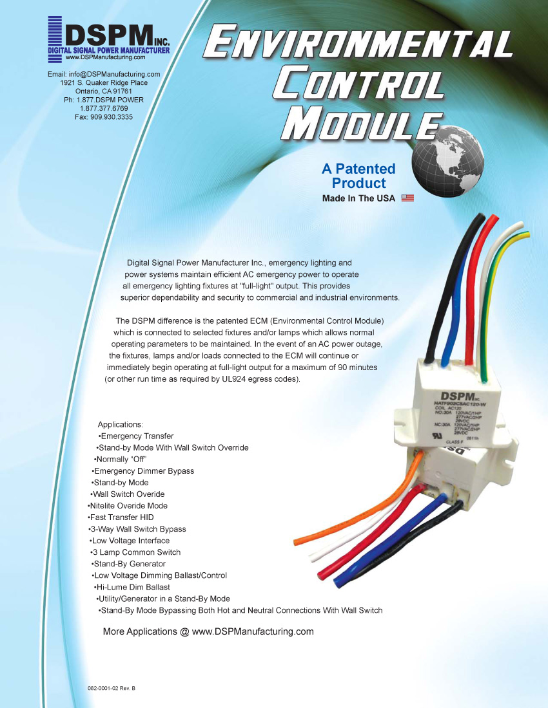
SINGLE PHASE 75-300W / PATENTABLE TECHNOLOGY

Slide 24
CENTRALIZED
LIGHTING
INVERTER APPLICATION

Slide 25


DIMMER BYPASS APPLICATION

Slide 26

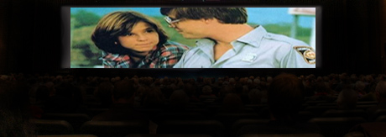

DIMMER BYPASS APPLICATION

Slide 27
DIMMER BYPASS APPLICATION
HERE’S WHAT HAPPENED AND HERE’S HOW IT WORKS…

Slide 28
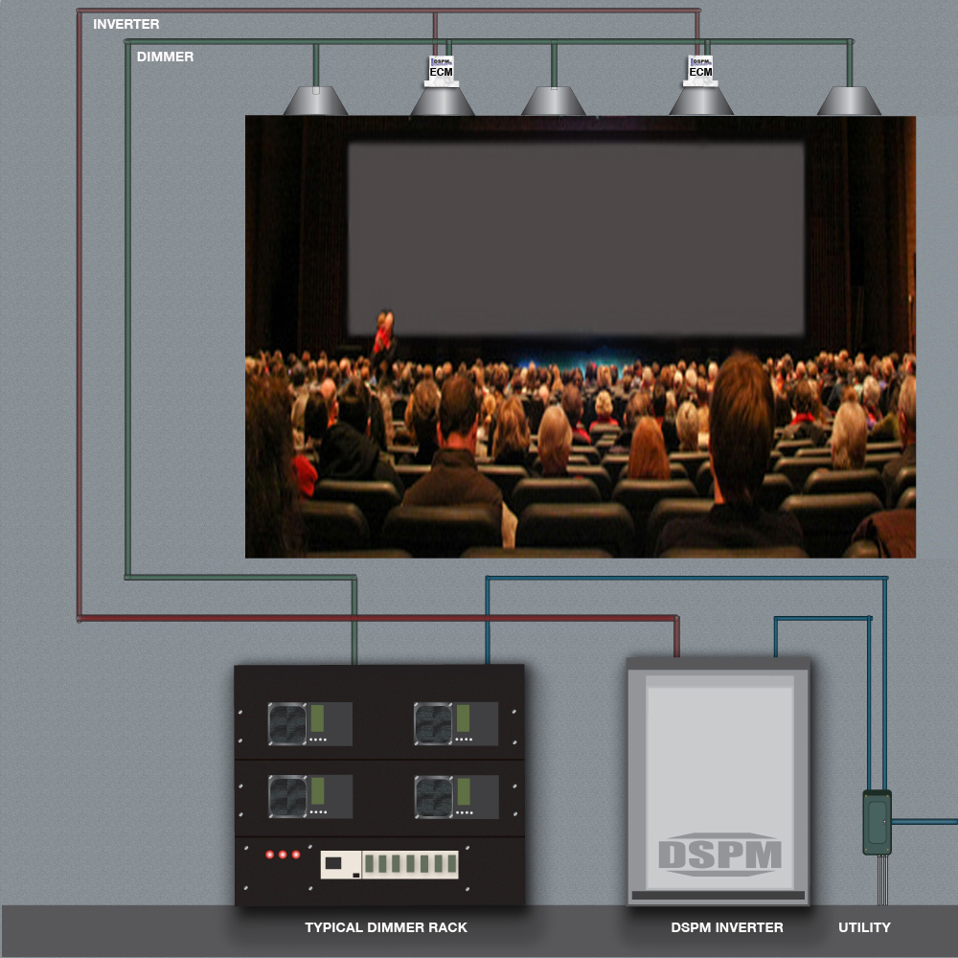
DIMMER BYPASS APPLICATION

Slide 29
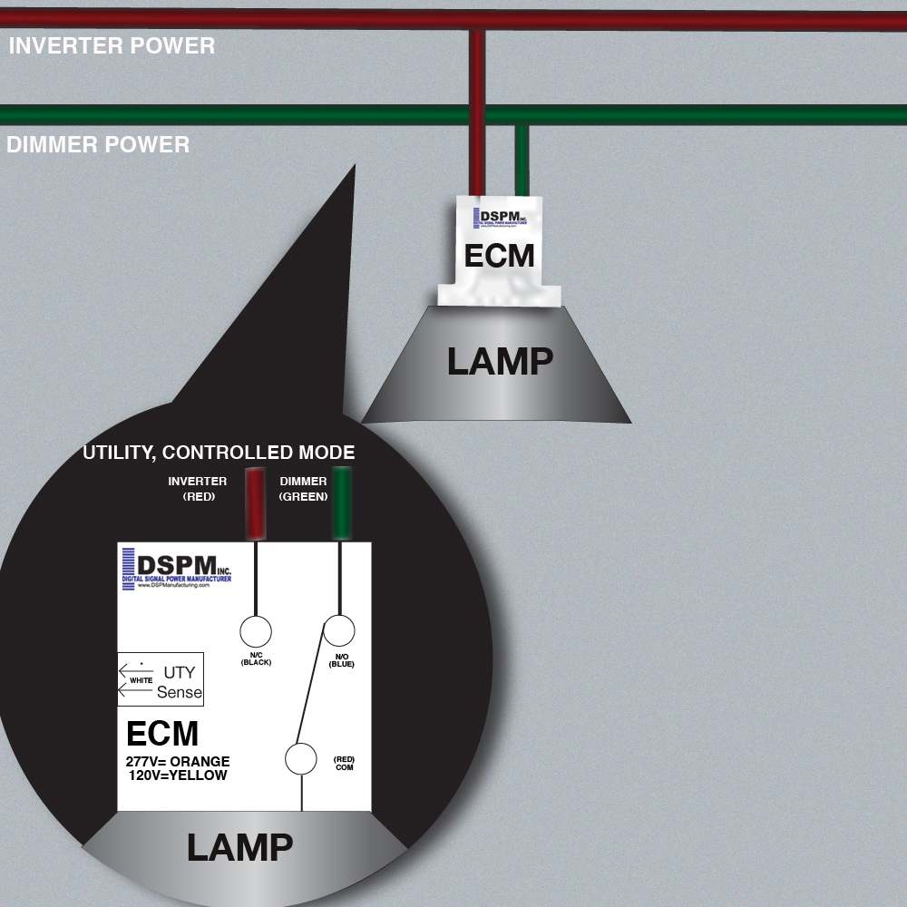
DIMMER BYPASS APPLICATION
The dimmer rack maintains full control over all of the lamps. Dimmer power is at normal luminosity.

Slide 30
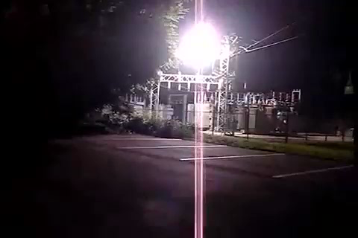
DIMMER BYPASS APPLICATION

Slide 31
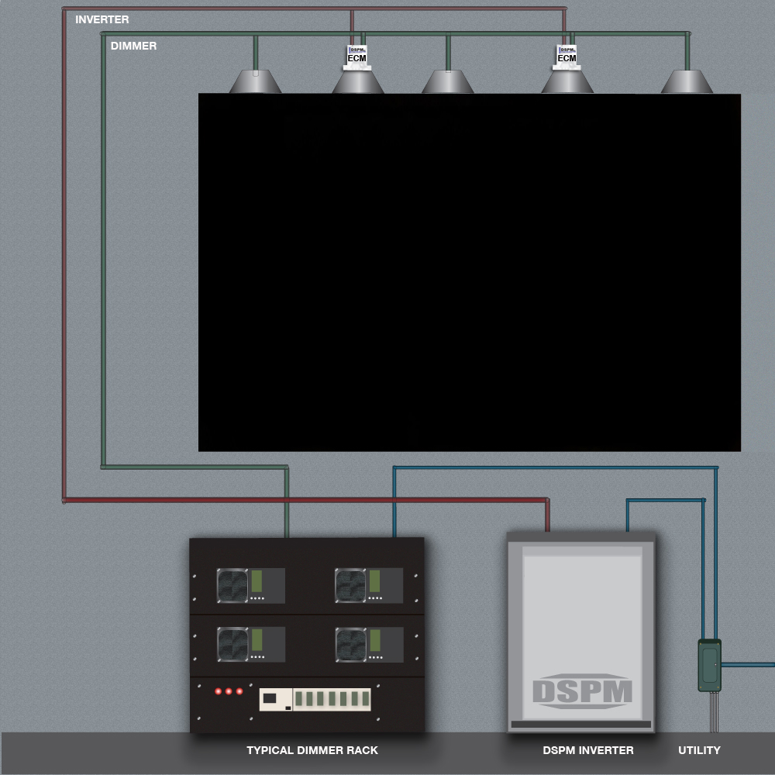
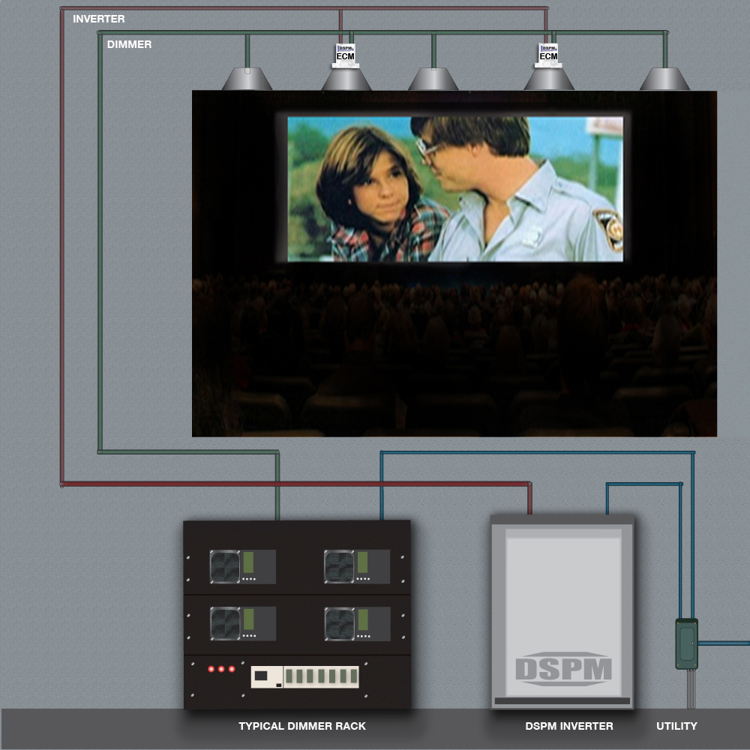
DIMMER BYPASS APPLICATION
BLACKOUT OCCURS
NORMAL OPERATING CONDITIONS

Slide 32
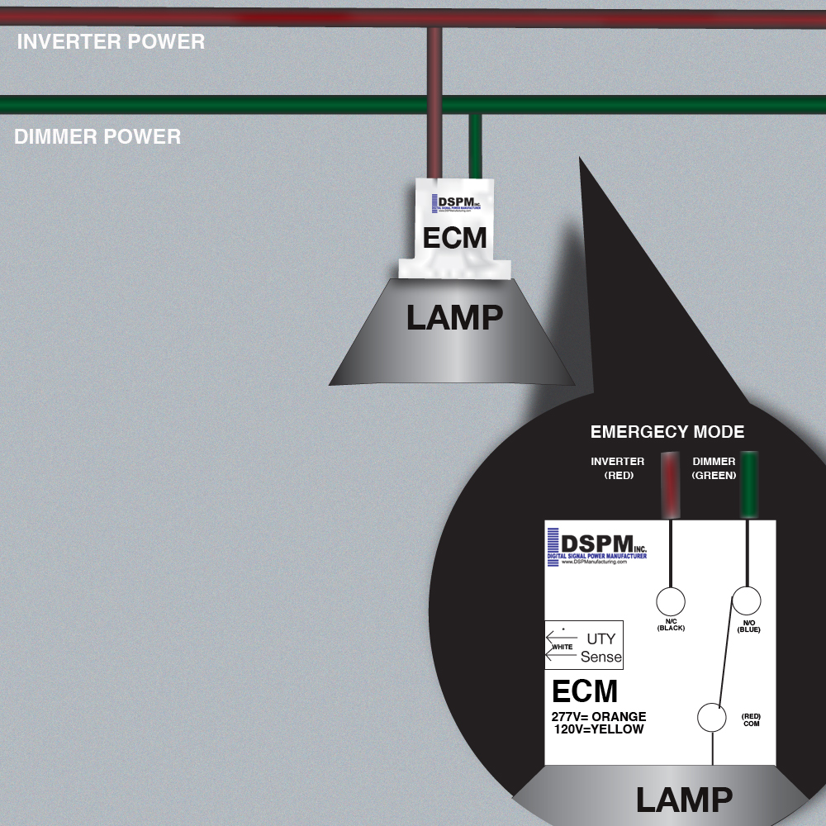


DIMMER BYPASS APPLICATION
When the dimmer rack power fails, the ECM switches the lamp to inverter power. Once the lights in the theater are at full luminosity, movie patrons can safely exit the room.

Slide 33
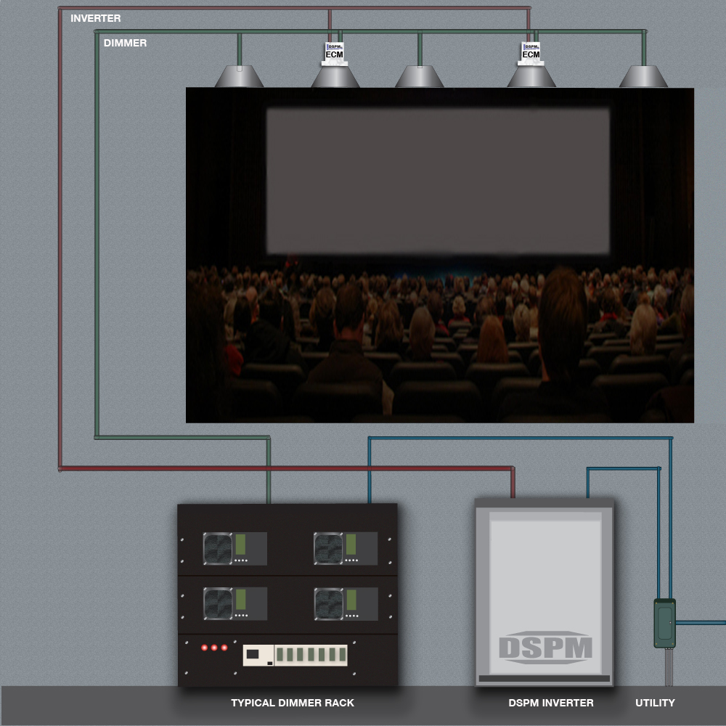
DIMMER BYPASS APPLICATION
ON EMERGENCY BACKUP

Slide 34
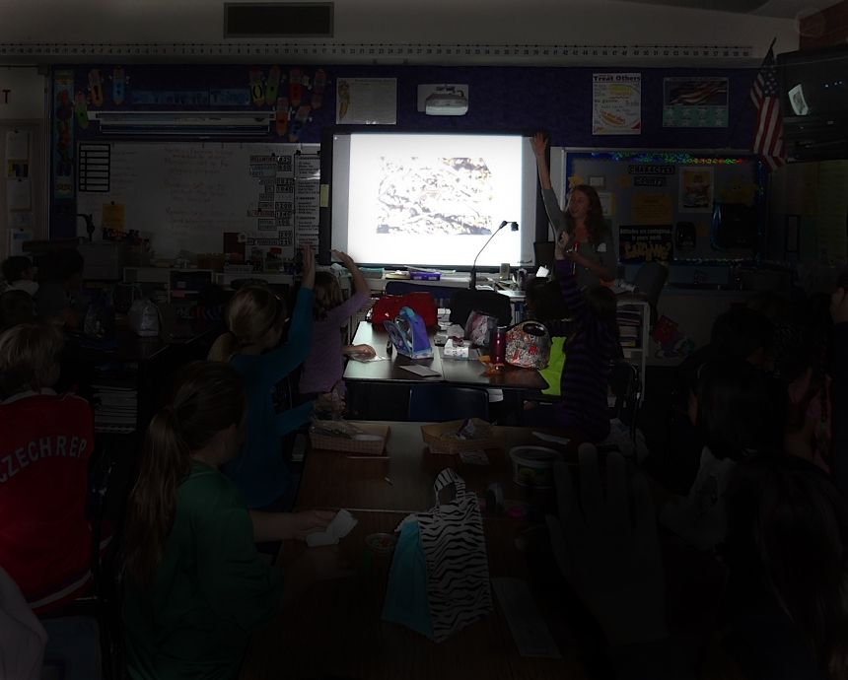
WALL SWITCH BYPASS

Slide 35
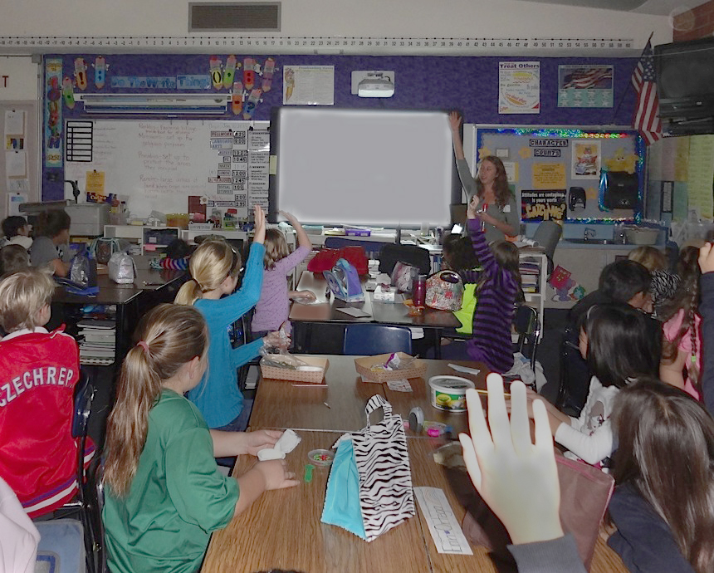

WALL SWITCH BYPASS

Slide 36
WALL SWITCH BYPASS
HERE’S HOW IT HAPPENED AND HERE’S HOW IT WORKS…

Slide 37
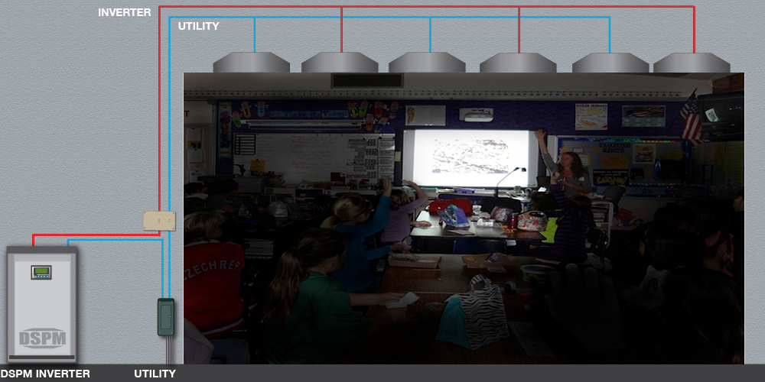
WALL SWITCH BYPASS

Slide 38
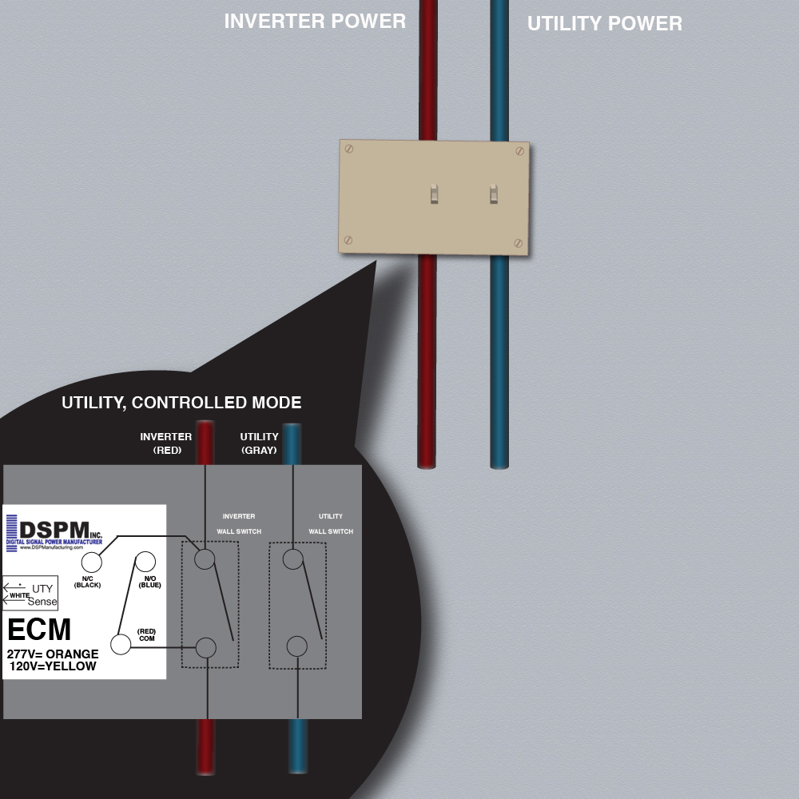
WALL SWITCH BYPASS
The wall switches maintain full control over all of the lamps. One is utility power and the other is the lighting inverter output. The teacher is lecturing her young students.

Slide 39
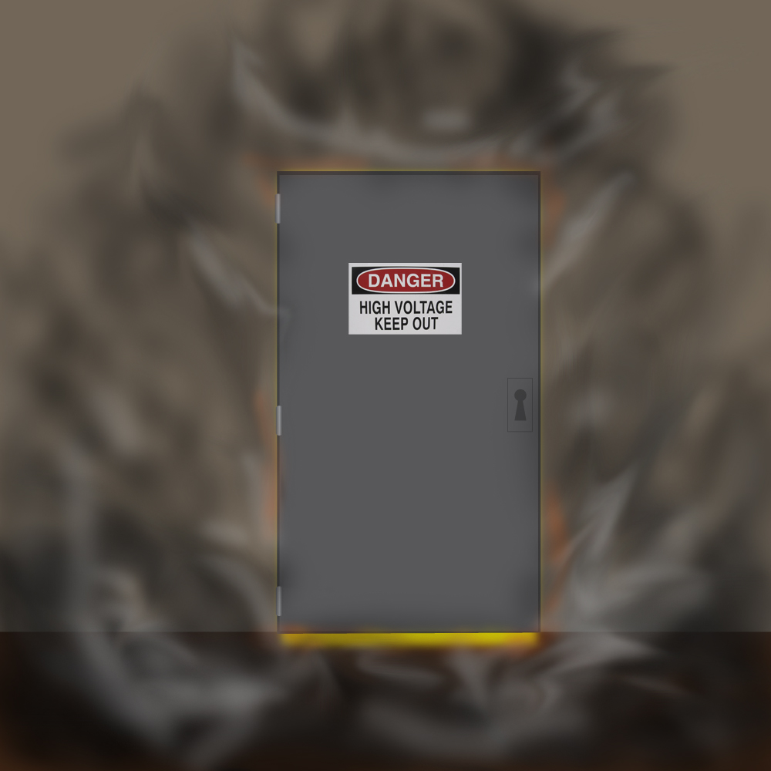

WALL SWITCH BYPASS

Slide 40
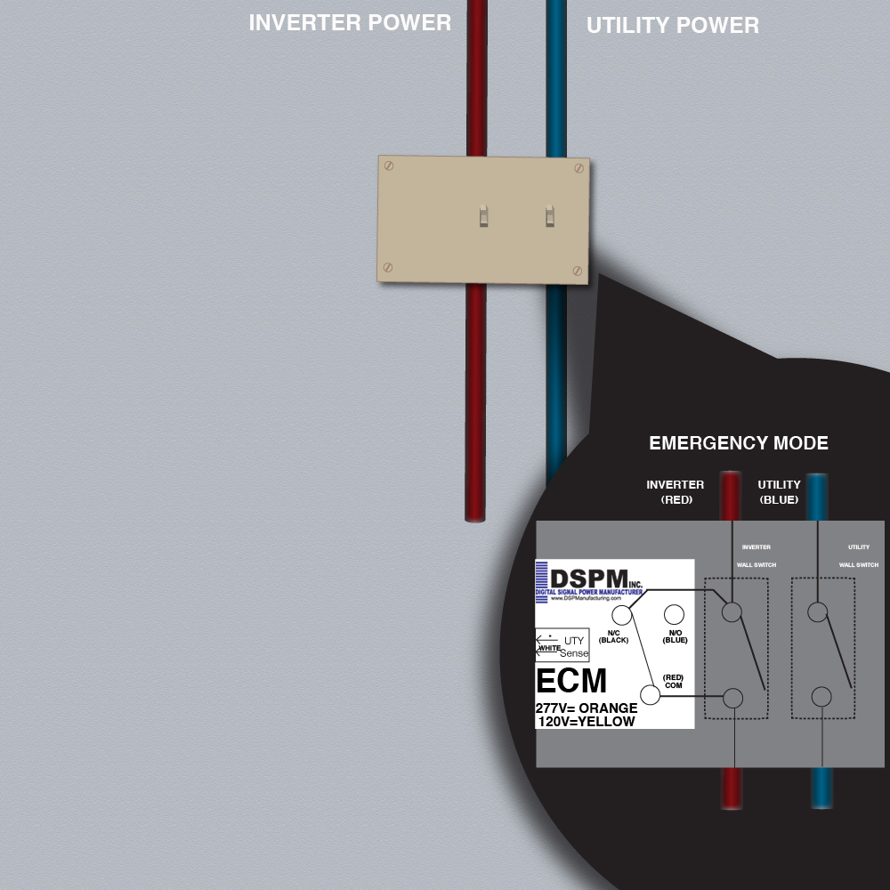


WALL SWITCH BYPASS
When a utility power outage occurs after an explosion, the ECM automatically switches to inverter power providing a paralleled path for the inverter to energize the lamps at full luminosity. Students and teacher can safely evacuate the classroom.

Slide 41
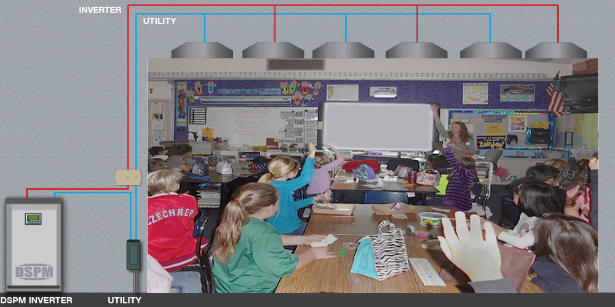
WALL SWITCH BYPASS

Slide 42
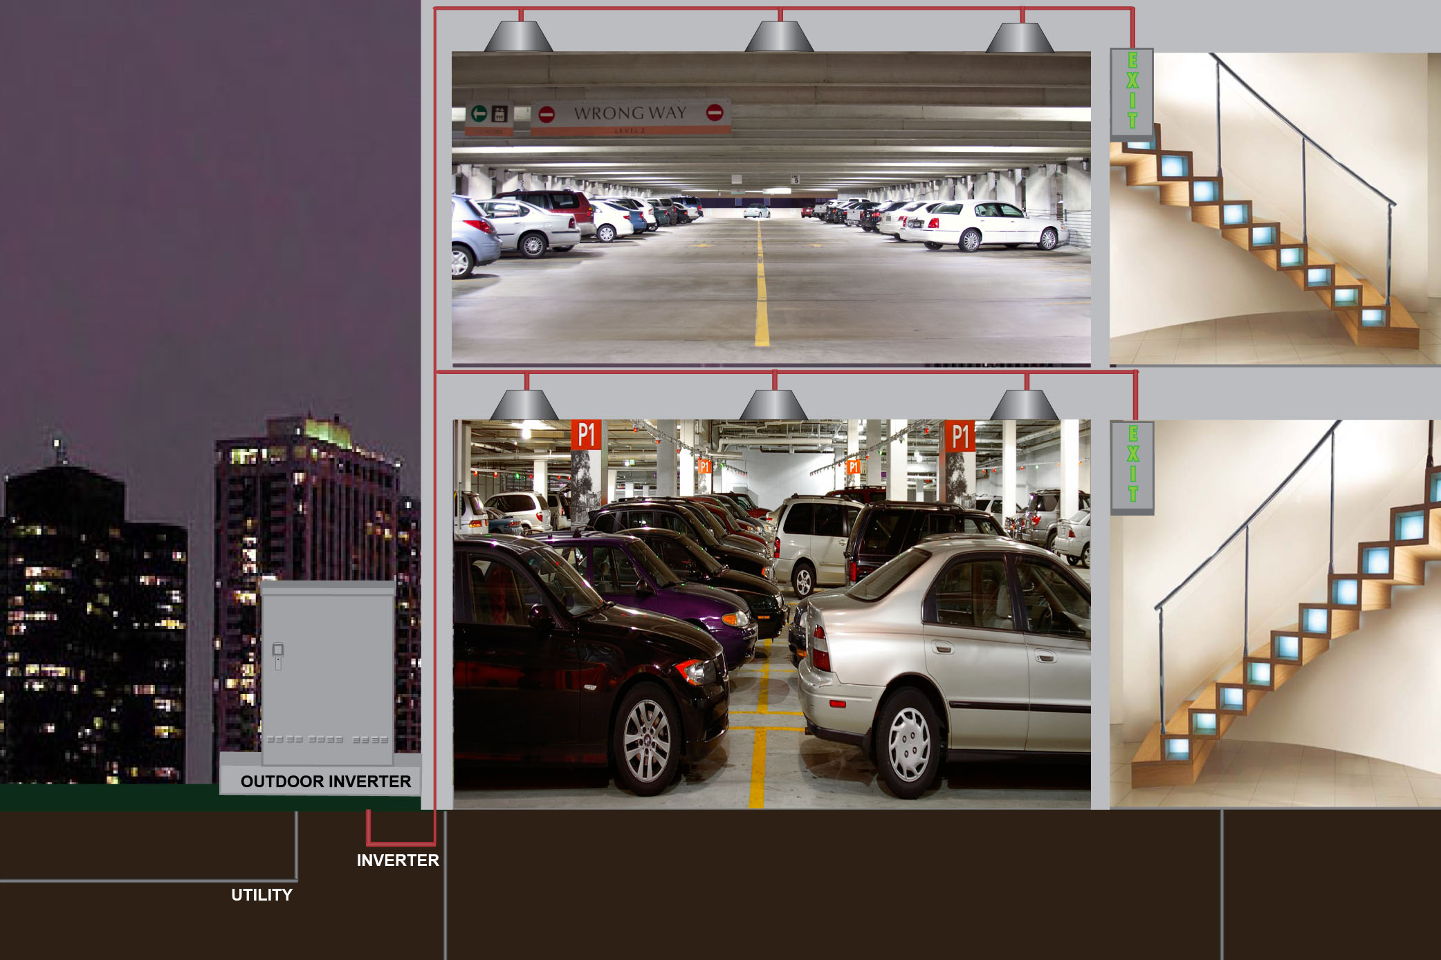
OUTDOOR INVERTER

Slide 43
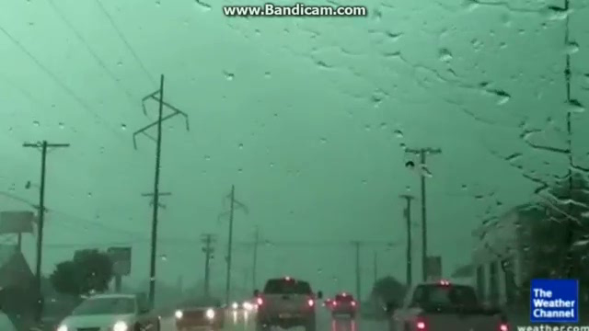
OUTDOOR INVERTER

Slide 44
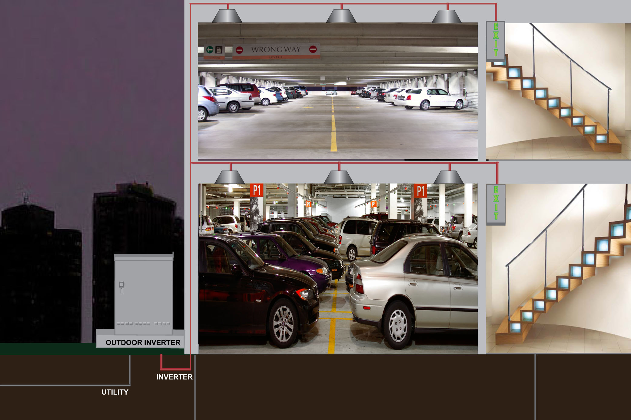
OUTDOOR INVERTER
No matter what type of weather disaster is occurring elsewhere, the DSPM’s outdoor inverter will always maintain full luminosity providing safety assurance.

Slide 45
LIFE SAFETY CODES II
(From Life Safety Code Handbook, 2012)
Maintenance Requirements
(4.6.12.1, Life Safety Handbook, 2012)
Whenever or wherever any device, equipment, system, condition, arrangement, level of protection, fire-resistive construction, or any other feature is required for compliance with the provisions with the Code, such device, equipment, system, condition, arrangement, level of protection, fire-resistive construction, or other feature shall thereafter be continuously maintained. Maintenance shall be provided in accordance with applicable NFPA requirements or requirements developed as part of a performance-based design.
Paragraph 4.6.12.1 emphasis the importance of maintaining items required by the Code. It is useless to have an egress door that will not open, a self-closing device that does not close the door, or a sprinkler system with no water.
Also, before taking any life safety features out of service, extreme care needs to be exercised to ensure that the feature is not required, was not originally provided as an alternative or equivalency, or is no longer required due to other new requirements in the current Code.
The Code directs that non-required life safety features that are obvious to the public are to be either maintained or removed to prevent false expectations or a false sense of security by building occupants. For example, if the water supply to a non-required wet standpipe system were permanently shut off because the system piping leaked but the hose and nozzle for occupant use were left attached to the standpipe, an occupant could be endangered while attempting to use the system. If the non-required standpipe system were turned off and abandoned, it would be necessary, as a minimum, to remove all hoses and nozzles and to place prominent signage at each outlet station advising that the system is out of service. The standpipe system piping, however, would not have to be removed.
(4.6.12.2, Life Safety Handbook, 2012)

Slide 46
LIFE SAFETY CODES II
(From Life Safety Code Handbook, 2012)
Code Requirements
(7.9.3.1, Life Safety Handbook, 2012)
7.9.3.1 Required emergency lighting systems shall be tested in accordance with one of the three options offered by 7.9.3.1.1, 7.9.3.1.2, or 7.9.3.1.3.
7.9.3.1.1 Testing of required emergency lighting systems shall be permitted to be conducted as follows:
Functional testing shall be conducted monthly, with a minimum of 3 weeks and a maximum of 5 weeks between tests, for not less than 30 seconds, except as otherwise permitted by 7.9.3.1.3(2).
The test interval shall be permitted to be extended beyond 30 days with the approval of the authority having jurisdiction.
Functional testing shall be conducted annually for a minimum of 1½ hours if the emergency lighting system is battery powered.
The emergency lighting equipment shall be fully operational for the duration of the tests required by 7.9.3.1.1(1) and (3).
Written records of visual inspections and tests shall be kept by the owner for inspection by the authority having jurisdiction.
(7.9.3.1.2, Life Safety Handbook, 2012)
7.9.3.1.2 Testing of required emergency lighting systems shall be permitted to be conducted as follows:
Self-testing/self-diagnostic battery-operated emergency lighting equipment shall be provided.
Not less than once every 30 days, self-testing/self-diagnostic, battery operated emergency lighting equipment shall automatically perform a test with a duration of a minimum of 30 seconds and a diagnostic routine.
Self-testing/self-diagnostic battery-operated emergency lighting equipment shall indicate failures by a status indicator.
A visual inspection shall be performed at intervals not exceeding 30 days.
Functional testing shall be conducted annually for a minimum of 1½ hours.
Self-testing/self-diagnostic battery-operated emergency lighting equipment shall be fully operational for the duration of the 1½-hour test.
Written records of visual inspections and tests shall be kept by the owner for inspection by the authority having jurisdiction.
(7.9.3.1.2, Life Safety Handbook, 2012)
7.9.3.1.3 Testing of required emergency lighting systems shall be permitted to be conducted as follows:
Computer-based, self-testing/self-diagnostic battery operated emergency lighting equipment shall be provided.
Not less than once every 30 days, emergency lighting equipment shall automatically perform a test with a duration of a minimum of 30 seconds and a diagnostic routine.
The emergency lighting equipment shall automatically perform annually a test for a minimum of 1½ hours.
The emergency lighting equipment shall be fully operational for the duration of the tests required by 7.9.3.1.3(2) and (3).
The computer-based system shall be capable of providing a report of the history of tests and failures at all times.

Slide 47
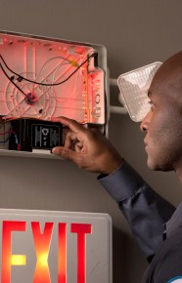

HOW IS IT DONE NOW
Maintaining And Testing Emergency Lighting For Code Compliance
Here are examples of workers in compliance with the Life Safety Code 7.9.3.1.1 and 7.9.3.1.2. Emergency lighting takes mandatory monthly/yearly maintenance.

Slide 48

HOW IS IT DONE NOW
Here is an example of an inverter sending companies automatic e-mail notifications they can access at any time in accordance with Life Safety Code 7.9.3.1.3.

Slide 49

EACH INVERTER ALSO COMES WITH TECHNICAL SPECIFICATIONS

Slide 50
WE TRULY HOPE THAT THE NEW CATALOGS ARE EASIER TO USE AND EXPLAIN ANY QUESTIONS THAT YOU MAY HAVE.
REMEMBER, IF YOU NEED DATA SHEETS THEY ARE AVAILABLE AS PDF’S WITH THE FIELDS READY TO FILL IN.

Slide 51

Thank you for watching!
If you have any questions please call
1.877.DSPM.POWER
(1.877.377.6769)

